Slide 1

Netflix Data Analysis Project
A Comprehensive Analysis Using Python, Google Cloud, and Tableau
Presenters:
Karan Parmar
Shrajna Shetty
Aman Khan

Slide 2
Objectives
The primary goal of this project is to analyze Netflix’s dataset to uncover insights about its content library, including trends in content creation, most popular genres, and content distribution across different regions and time periods. This project also aims to build a visually engaging dashboard for storytelling using Tableau.
Problem Statement
Netflix’s extensive library lacks an easily accessible summary of trends for informed decision-making.
Challenges included integrating cloud storage with Tableau and ensuring clean and consistent data for analysis.
Deciding on the most suitable cloud platform (e.g., GCP, IBM Cloud, Oracle Cloud Infrastructure) required detailed comparisons and discussions.

Slide 3
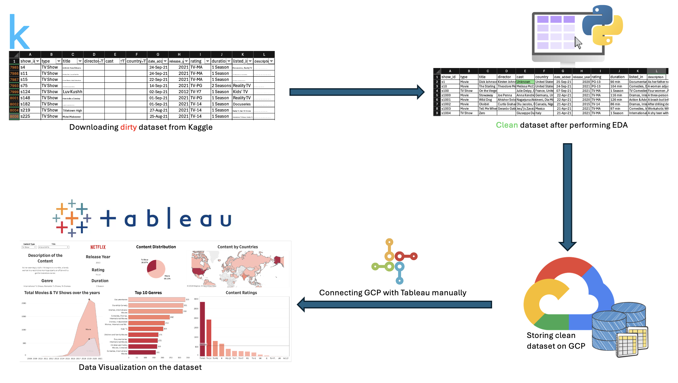
Data Architecture Diagram

Slide 4
Roles and Responsibilities Matrix
Responsibility | Karan | Shrajna | Aman
Brainstorming & Planning | Discussed project scope and tools. Provided ideas on data structure and tools. | Collaborated in brainstorming. Suggested key data visualization ideas. Identified visual elements for Tableau. | Contributed to brainstorming. Highlighted data cleaning needs. Proposed key EDA methods.
Tool Research | Explored cloud options. Conducted comparisons between GCP, IBM Cloud, and Oracle Cloud. | Researched Tableau’s functionality and features. | Researched cleaning techniques and visualization standards. Suggested Python libraries for EDA.
Data Cleaning | Shared raw data with the team. Participated in discussions on cleaning methods. | Collaborated on defining cleaned data requirements. Ensured cleaning aligned with visual goals. | Led cleaning process. Worked on structuring the cleaned data.
EDA | Contributed resources for analysis. | Provided suggestions for EDA insights relevant to visualization. | Led EDA efforts. Generated insights from the cleaned data.
GCP Management | Finalized GCP. Uploaded cleaned data to GCP Storage. Connected GCP with Tableau, manually | Supported with data upload. | Provided feedback during GCP testing. Ensured data compatibility post upload.
Tableau Dashboard | Assisted in deciding visual elements and filter designs. | Designed and built the Tableau dashboard. Finalized charts and interactions. Used student ID for Tableau access. | Reviewed dashboards and provided insights for refinement. Tested dashboard usability.

Slide 5
Steps of the Project
Step 1: Data Collection
Source: Netflix dataset in CSV format from Kaggle.
Reviewed dataset for relevance and completeness.
Step 2: Data Cleaning and EDA
Cleaning involved handling missing values, ensuring consistent formats, and removing duplicates.
EDA: Performed using Python libraries like Pandas and Matplotlib to uncover trends in
Netflix’s content library.
Exploratory Data Analysis (EDA) on Netflix Dataset
Below are the structured steps for EDA, written for inclusion in a report. Each step includes a brief explanation and key code snippets to provide clarity.

Slide 6
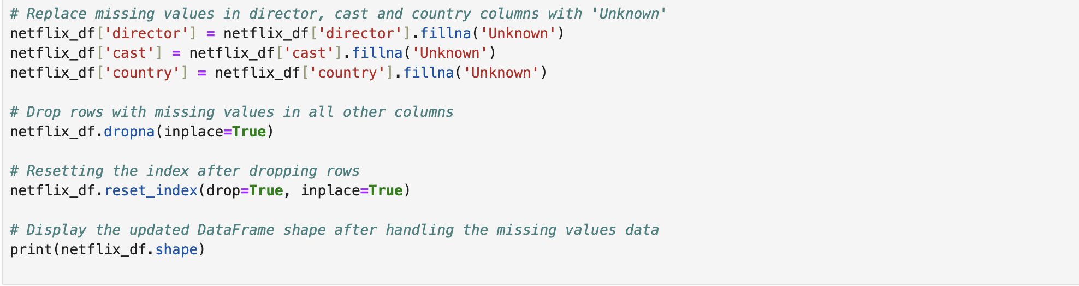
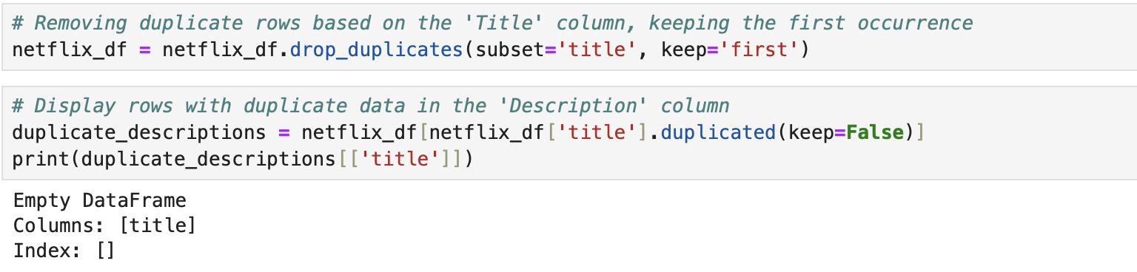
Data Cleaning Methods used
The data-cleaning methods used in the code involve several key techniques to handle missing values, duplicate data, and inconsistencies in the dataset.
Handling Missing Values: Missing values in specific columns such as ‘director’, ‘cast’, and ‘country’ are filled with the placeholder value "Unknown" using the ‘fillna()’ method. For other columns with missing values, rows are completely removed using the ‘dropna()’ function to ensure that the dataset remains complete for analysis. After dropping rows, the index is reset to maintain consistency in row numbering.
Removing Duplicates: Duplicate rows based on the ‘title’ column are removed with ‘drop_duplicates()’, ensuring that only the first occurrence of each title is retained. This helps eliminate redundancy in the dataset.
Renaming Columns: The ‘type’ column is renamed to ‘content type’ to enhance clarity and consistency in the dataset, ensuring the column name better reflects the information it holds.

Slide 7
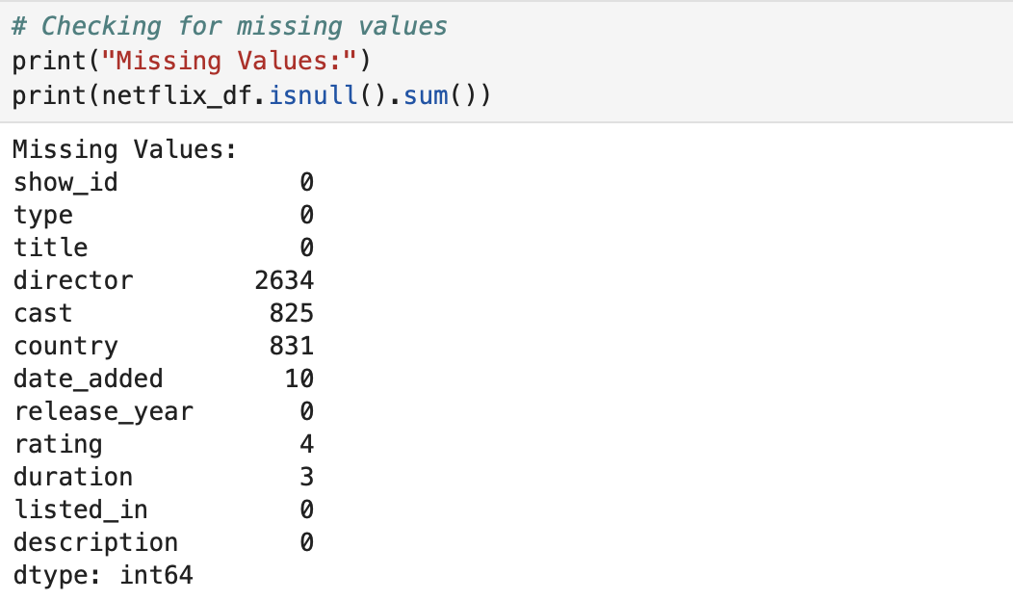
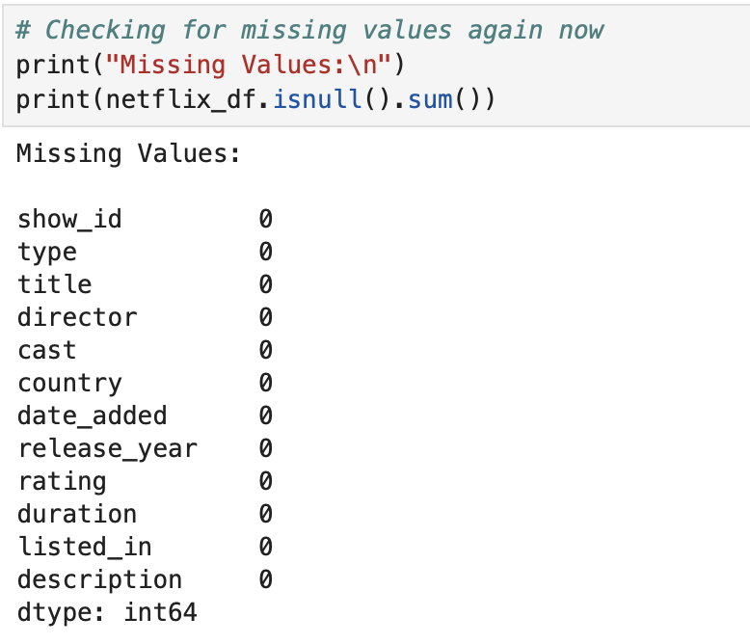
Data Cleaning Methods used (Cont.)
Converting Data Types: The ‘date_added’ column is converted into a datetime format using ‘pd.to_datetime()’, allowing for easier time-based analysis. Invalid date values are coerced into ‘NaT’ (Not a Time) if any errors are encountered during the conversion.
Filtering Data: Data is filtered based on specific criteria, such as identifying TV shows added after a certain date or filtering content with long durations, such as multiple seasons or movies longer than 90 minutes. This allows for more focused analysis on relevant content.
Validating the Cleaned Data: After the data-cleaning steps, missing values are rechecked to ensure all necessary adjustments have been made, and the final shape of the dataset is reviewed to confirm the removal of incomplete or duplicate rows.

Slide 8
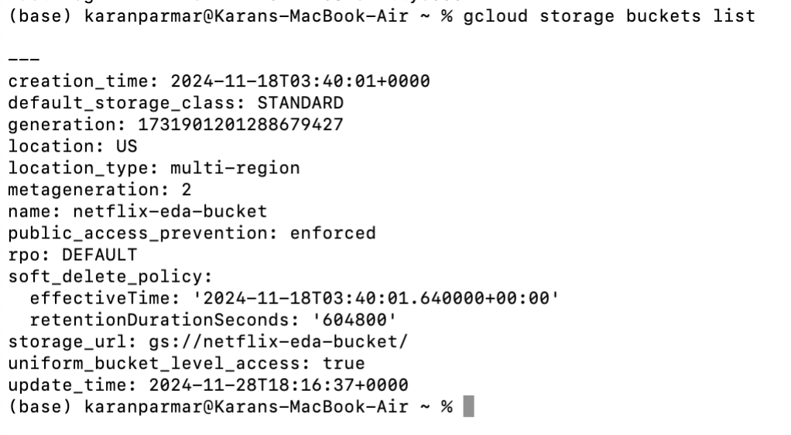
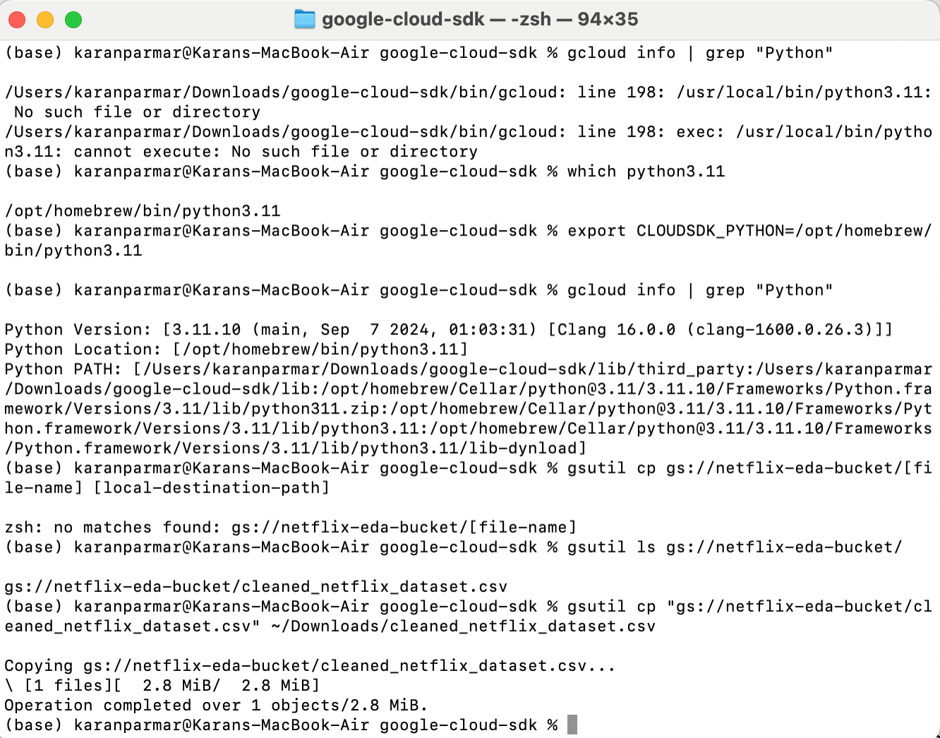
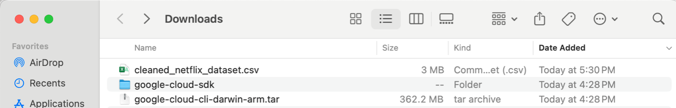
Step 3: Cloud Integration
Using Google Cloud Platform (GCP) for Data Storage and Tableau Web
We utilized GCP to securely store and manage the cleaned dataset. To enable visualization in Tableau Web, the dataset was manually downloaded and uploaded.
Key Steps:
- Google Cloud SDK Setup: Installed and configured the SDK using ‘gcloud init’ for authentication and project setup.
- Bucket Access Verification: Listed and confirmed the bucket (netflix-eda-bucket) containing the dataset.
- File Download: Located and downloaded the cleaned dataset using ‘gsutil cp’.
This integration ensured secure storage and seamless access for analysis.

Slide 9
Step 4: Tableau Dashboard Design
Visualization Creation: Designed bar charts, pie charts, and other visuals to analyze Netflix trends using Tableau's drag-and-drop interface.
Interactive Dashboards: Combined visuals into an interactive dashboard for clear insight presentation.
Save and Share: Published the dashboard on Tableau Web with a public link for easy access and sharing.

Slide 10
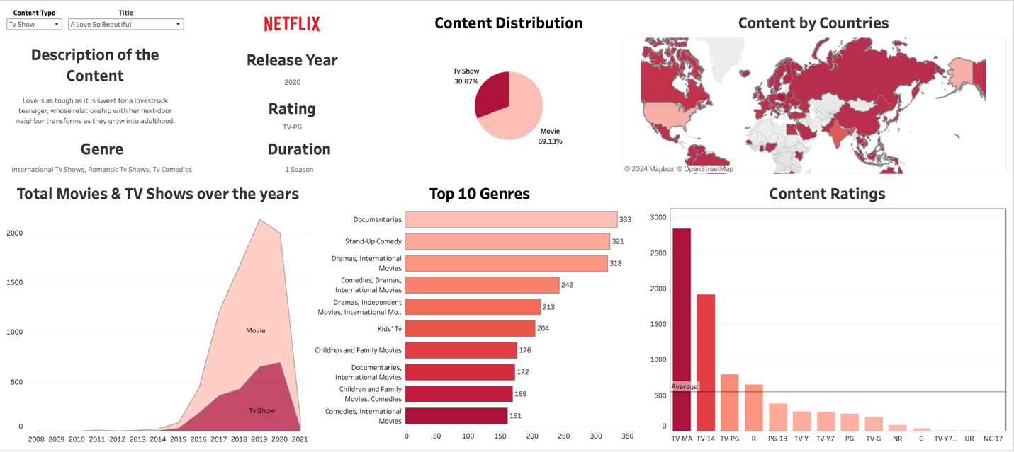
Tableau Dashboard Representation
Using publicly available data and free Tableau access via Northeastern University, we created an interactive dashboard focusing on key insights into Netflix’s content strategy:
Content Distribution of Movies and TV Shows:
Movies dominate the catalog (69.13%), with TV shows steadily growing (30.87%) to match binge-watching trends.
Content Distribution by Countries:
USA and India lead in content volume, reflecting Netflix’s global and regional focus.
Total TV Shows and Movies Added Over the Years:
A surge in original content post-2015 highlights Netflix’s emphasis on content creation.
Top 10 Genres:
Popular genres like Documentaries, Stand-up Comedy, and Drama cater to diverse audiences.

Slide 11
References
[1] https://help.tableau.com/current/pro/desktop/en-us/examples_googlecloudstorage.htm [2] https://help.tableau.com/current/pro/desktop/en-us/examples_textfile.htm [3] https://public.tableau.com/en-us/s/ [4] https://pandas.pydata.org/docs/ [5] https://plotly.com/python/ [6]https://www.kaggle.com/datasets [7] https://www.youtube.com/watch?v=BTArwS4ljC4 [8] https://www.youtube.com/watch?v=DyU51nRqcHg

Slide 12
Conclusion
This project highlights our team’s collaborative efforts in analyzing Netflix’s dataset to uncover meaningful insights into content trends and strategies. Through extensive exploratory data analysis (EDA) and effective visualization in Tableau, we identified patterns in genres, release periods, and audience preferences.
Overcoming challenges such as integrating Google Cloud Platform (GCP) with Tableau showcased our adaptability and technical expertise. This seamless integration of tools emphasizes our commitment to delivering comprehensive, data-driven solutions.
The project demonstrates how teamwork and technical skills can transform complex datasets into actionable insights, enabling informed decision-making through innovative visualizations.

Slide 13
Thank You!

